Slide 1




SmartServe: an Intelligent and Interactive Vending Machine logic System
EEE 304 Digital Electronics Laboratory
Submitted by – Group 6
1
Ameer Hamja Ibne Jamal
1906177
Fahim Shahriar Anim
1906178
Yeasir Arafat Prodhan
1906191
U Mong Sain Chak
1906195

Slide 2
Outline
Summary
Introduction
Design
Implementation
Analysis and Evaluation
References
Presented by: 1906XXX

Slide 3
1. Abstract
he basic goal of this project is to design the control unit of a classic Vending Machine with a synchronous sequential circuit(FSM)
Presented by: 1706XXX

Slide 4
2. Introduction
Problem Statement
Public places including airports, railway and bus stations, school and other educational institutions, commercial places, such as office buildings, hospitals, and shopping malls, often have a diverse population with varying preferences and dietary needs.
Operating a traditional store or cafeteria within the above mentioned places can have some limitations such as:
High Labor and Maintenance Cost
Limited Operating Hours
Lack of Convenience and Speed
Higher Risk of Theft or Vandalism
Higher Inventory Space
Presented by: 1706XXX

Slide 5
2. Introduction
Proposed Solution
Automated self-service machines or Vending machines, that can dispense various products, typically snacks, beverages, or other small items can be a solution corresponding the issue stated.
Advantages of a Vending Machine
Convenience for Customers
Vending machines provide a convenient option for customers to quickly access snacks, beverages, or other products without the need to leave the premises or visit a separate store. This saves time and offers a convenient solution for those who may have limited break times or busy schedules.
24/7 Availability
Unlike traditional stores with fixed operating hours, vending machines can operate 24/7. Vending machines ensure that products are available at all times, catering to the needs of people working late shifts or those with unconventional schedules.
Cost Efficiency
Vending machines offer a more cost-efficient solution, requiring less space, fewer staff members, and lower overhead costs. They provide a self-service model that minimizes labor expenses while still meeting customer needs.
Space Optimization
Vending machines require relatively small footprints, making them ideal for commercial places where space may be limited or at a premium. They can be placed in corridors, waiting areas, break rooms, or other underutilized spaces, optimizing the use of available real estate.
Security
Vending machines are designed with security features to prevent theft and vandalism.
Presented by: 1706XXX

Slide 6
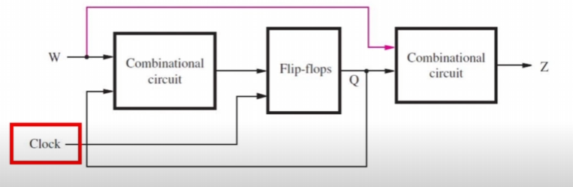
3.1 Design: Methods
Theory: Synchronous Sequential Circuits
Sequential Circuits (also known as Finite state Machine) are basically a type of circuit in which the output depends on the past behavior as well as the present values of input. When a clock signal is used to control the operation of the system, it can be called as Synchronous Sequential Circuit. Synchronous sequential circuits are implemented using combinational logic and one or more flipflops.
Presented by: 1706XXX

Slide 7
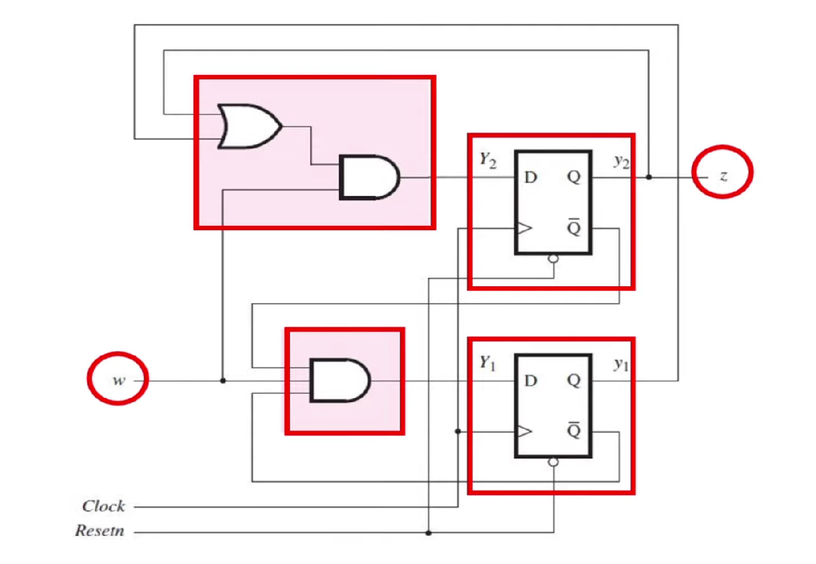
3.1 Design: Methods
Theory: Synchronous Sequential Circuits
The values of the flipflops are referred to as the ‘States’.
Under control of the clock signal, the flipflop output changes state as determined by the combinational logic unit.
Thus, the circuit moves from one state to another
Presented by: 1706XXX

Slide 8
3.1 Design: Methods
Theory: Synchronous Sequential Circuits
The values of the flipflops are referred to as the ‘States’.
Under control of the clock signal, the flipflop output changes state as determined by the combinational logic unit.
Thus, the circuit moves from one state to another
Presented by: 1706XXX

Slide 9
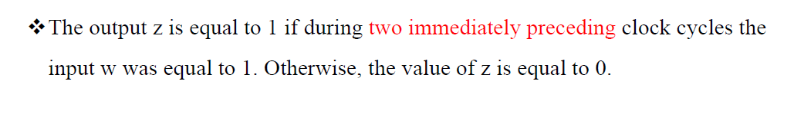
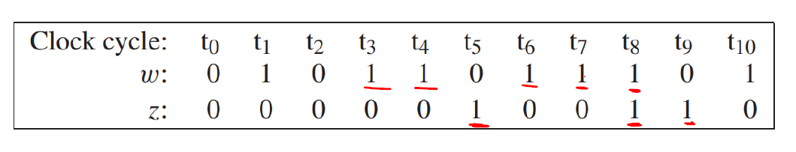
3.1 Design: Methods
Theory: Synchronous Sequential Circuits
In this project we will be implementing the Moore Type Synchronous Sequential Circuit. A Moore Machine is an FSM whose output depends on the present state only, it does not depend on current input. For example:
Presented by: 1706XXX

Slide 10
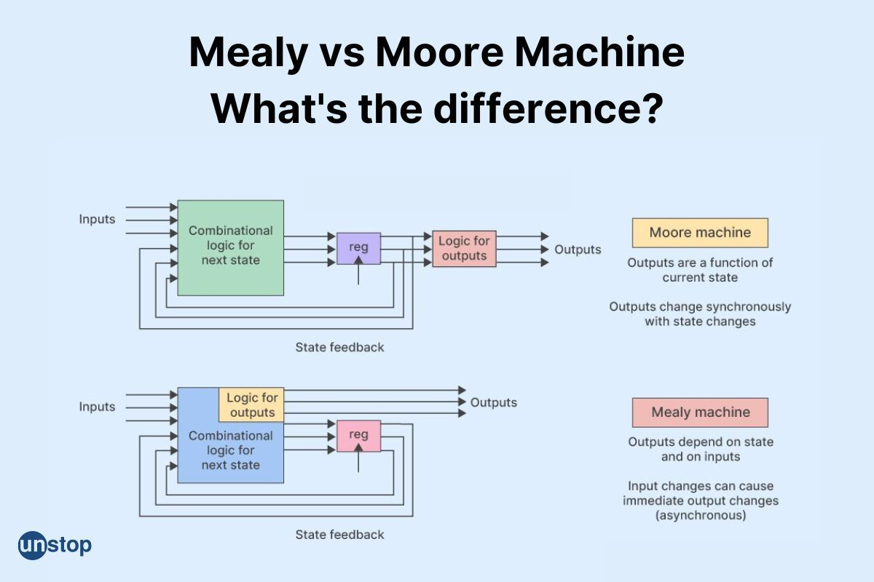
3.1 Design: Methods
Presented by: 1706XXX

Slide 11
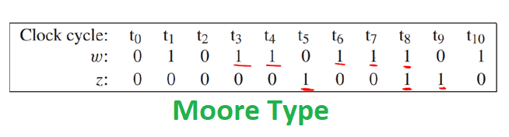
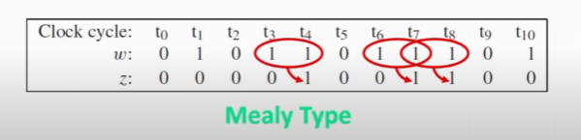
3.1 Design: Methods
Presented by: 1706XXX

Slide 12
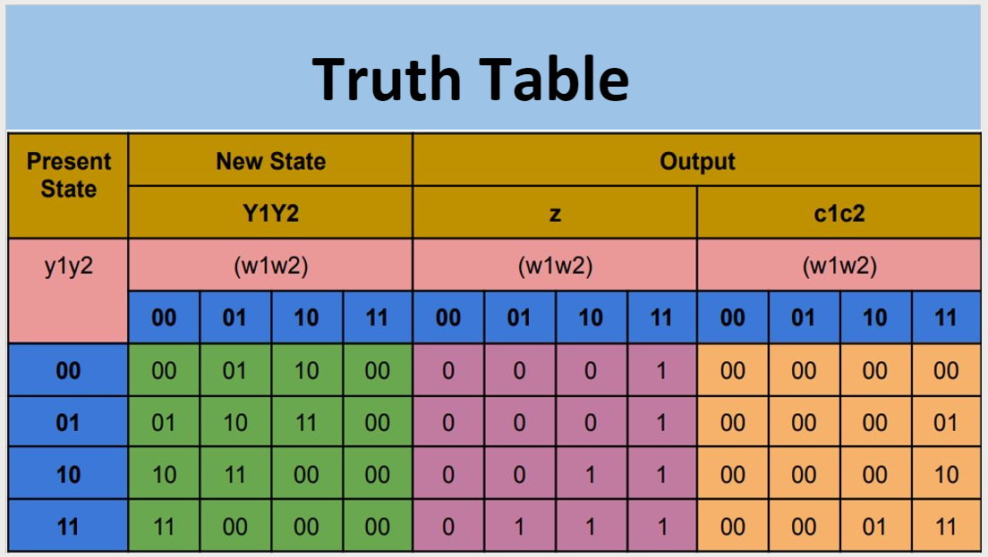
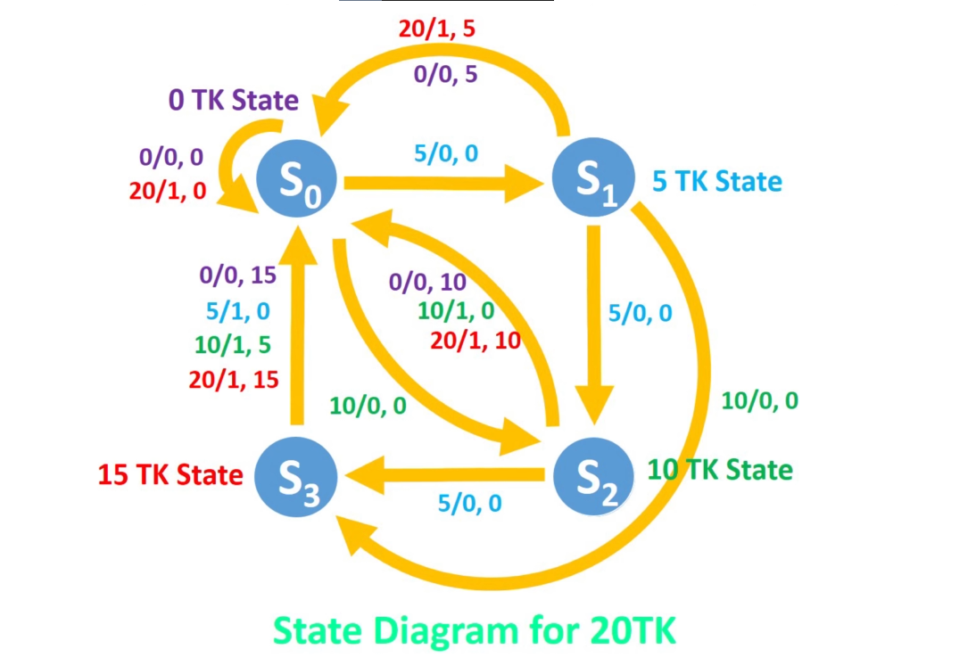
3.1 Design: Methods Using Mealy
Presented by: 1706XXX

Slide 13
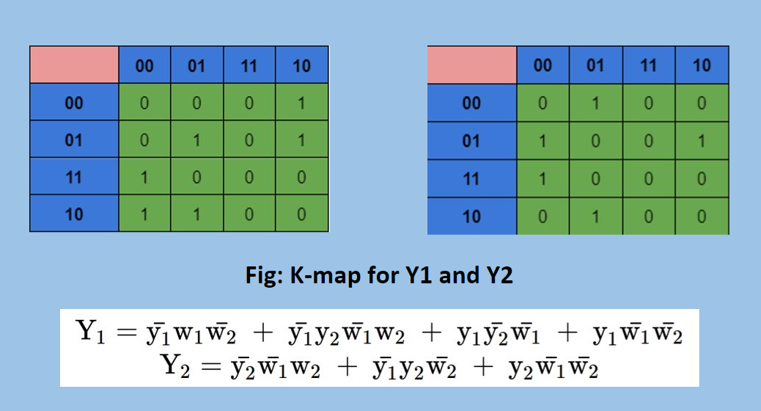
3.1 Design: Methods Using Mealy
Presented by: 1706XXX

Slide 14
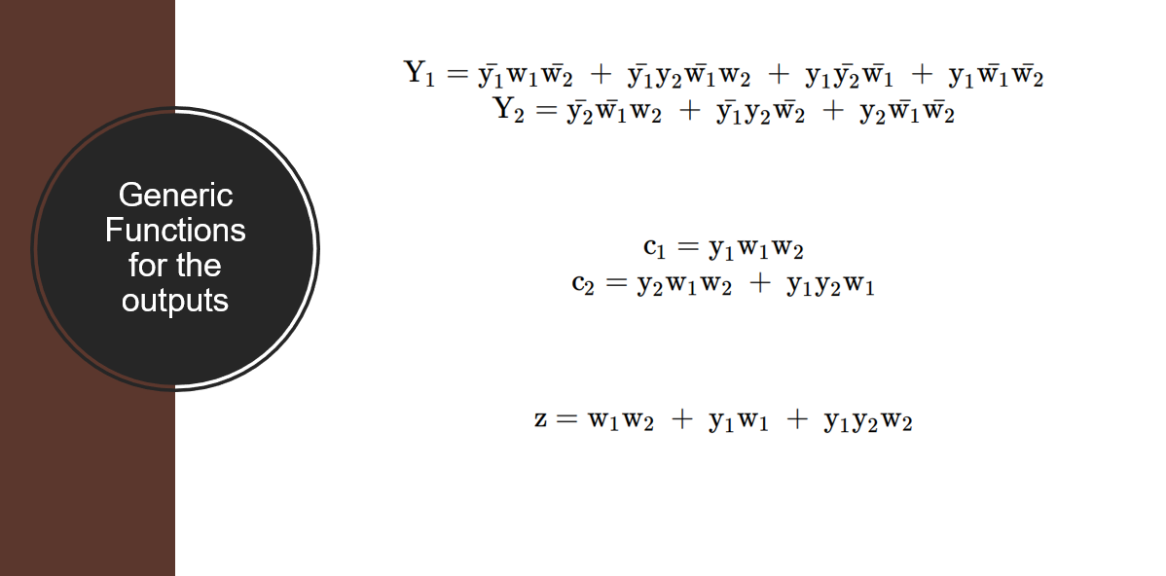
3.1 Design: Methods Using Mealy
Presented by: 1706XXX

Slide 15
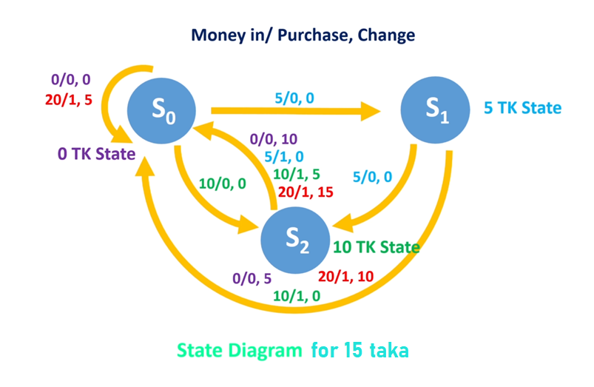
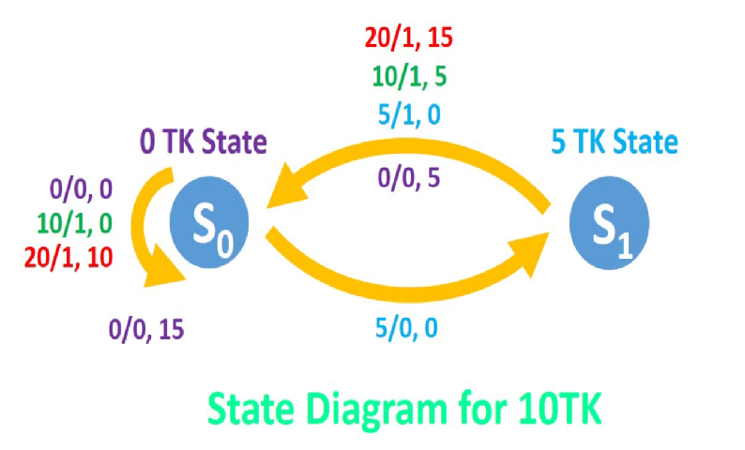
3.1 Design: Methods Using Mealy
Presented by: 1706XXX

Slide 16
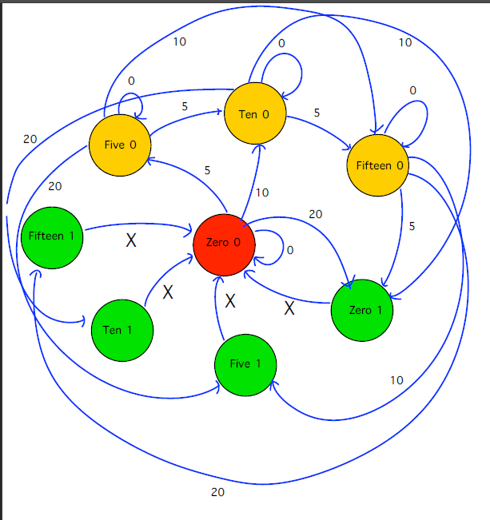
3.1 Design: Methods Using Moore
State Diagram for 20 TK Product
Presented by: 1706XXX

Slide 17
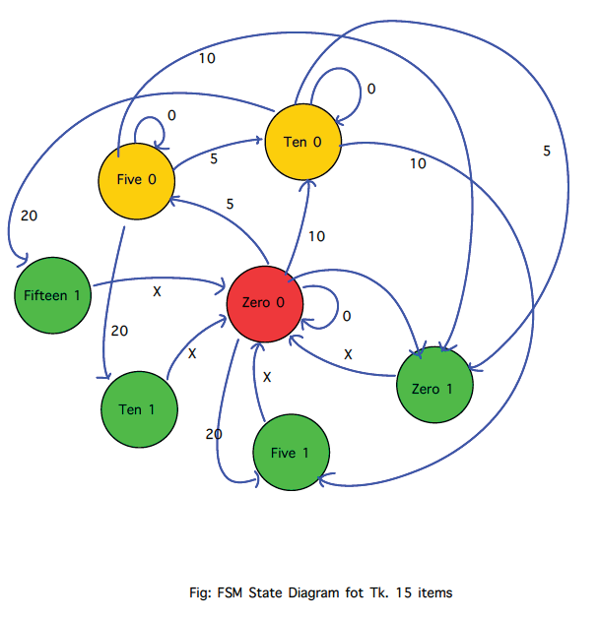
3.1 Design: Methods Using Moore
State Diagram for 15 TK Product
Presented by: 1706XXX

Slide 18
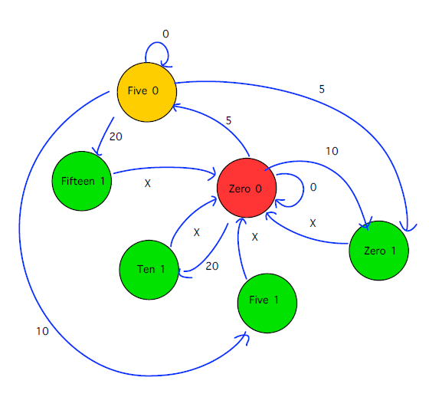
3.1 Design: Methods Using Moore
State Diagram for 10 TK Product
Presented by: 1706XXX

Slide 19
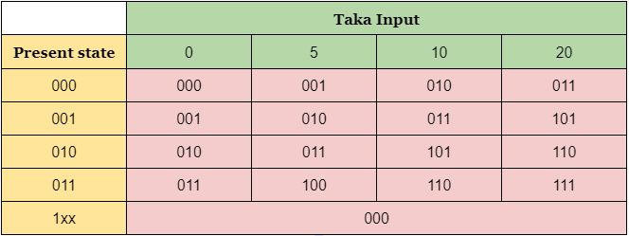
3.1 Design: Methods Using Moore
State Table for 20 TK Product
Presented by: 1706XXX

Slide 20
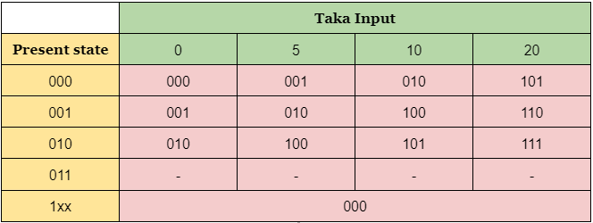
3.1 Design: Methods Using Moore
State Table for 15 TK Product
Presented by: 1706XXX

Slide 21
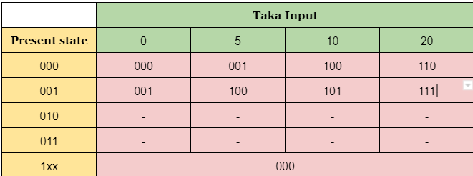
3.1 Design: Methods Using Moore
State Table for 10 TK Product
Presented by: 1706XXX

Slide 22
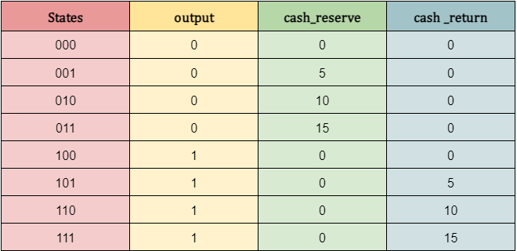
3.1 Design: Methods Using Moore
State Table for output, cash reserve and cash return
Presented by: 1706XXX

Slide 23
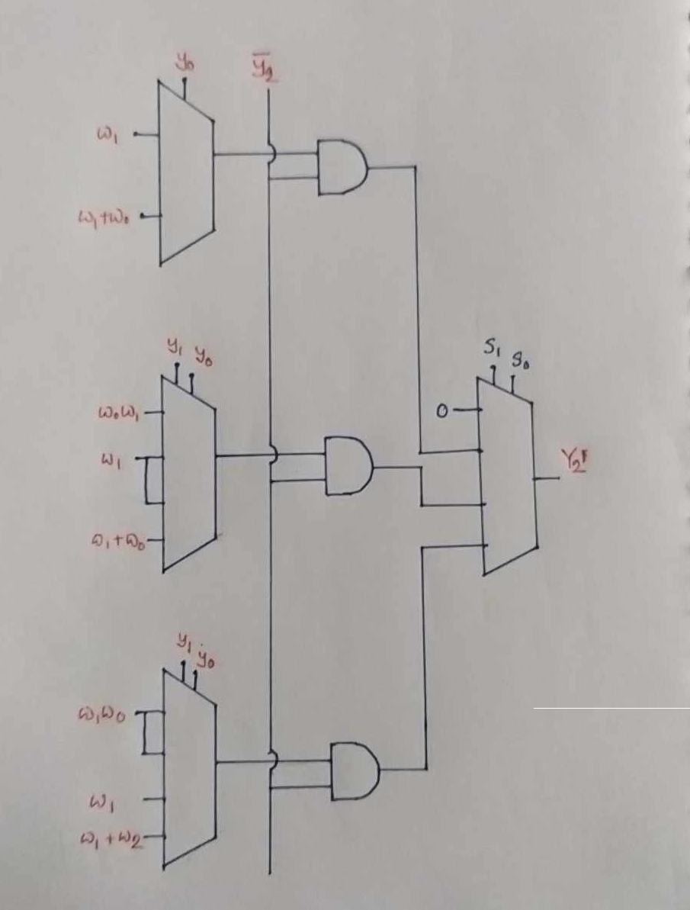
3.1 Design: Methods Using Moore
Using Boolean Algebra
Presented by: 1706XXX

Slide 24
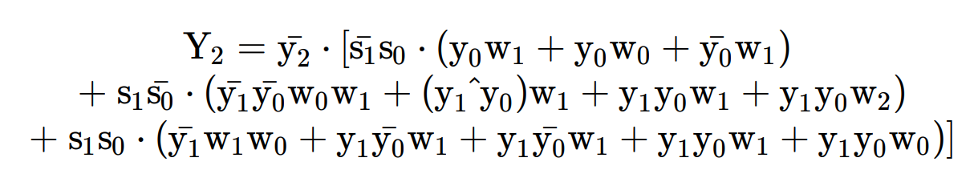
3.1 Design: Methods Using Moore
Presented by: 1706XXX

Slide 25
3.1 Design: Choosing Moore over Mealy
As in Mealy machine output depends on present output, while changing the selection of product a garbage value is shown in posedge clock.
In comparison, in Moore machine output does not depend on present input, hence no disturbance is seen.
Presented by: 1706XXX

Slide 26
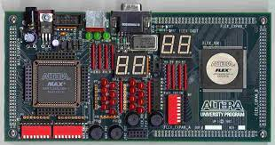
3.2 Design: Components
Components used in this project
Altera UP2 Development Kit
7 segment displays
Resistors
Presented by: 1706XXX

Slide 27
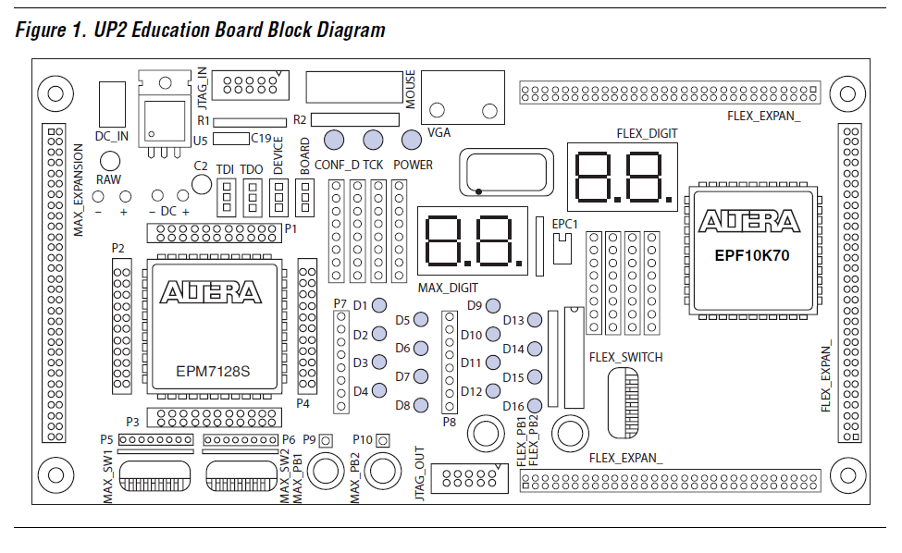
3.2 Design: About Altera UP2 Development Kit
The UP2 Education Board is a stand-alone experiment board based on a FLEX® 10K device and includes a MAX® 7000 device. In our project we needed the FLEX 10K device only.
Presented by: 1706XXX

Slide 28
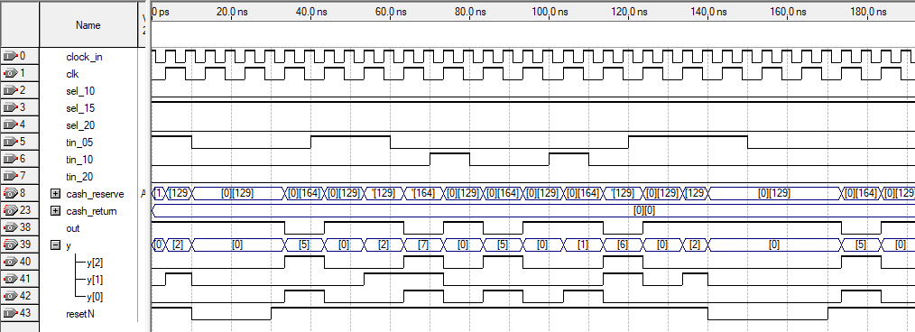
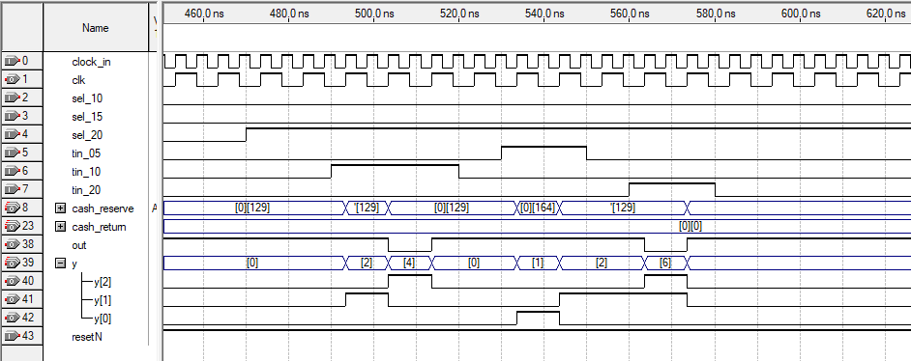
3.3 Design: Simulation
Presented by: 1706XXX

Slide 29
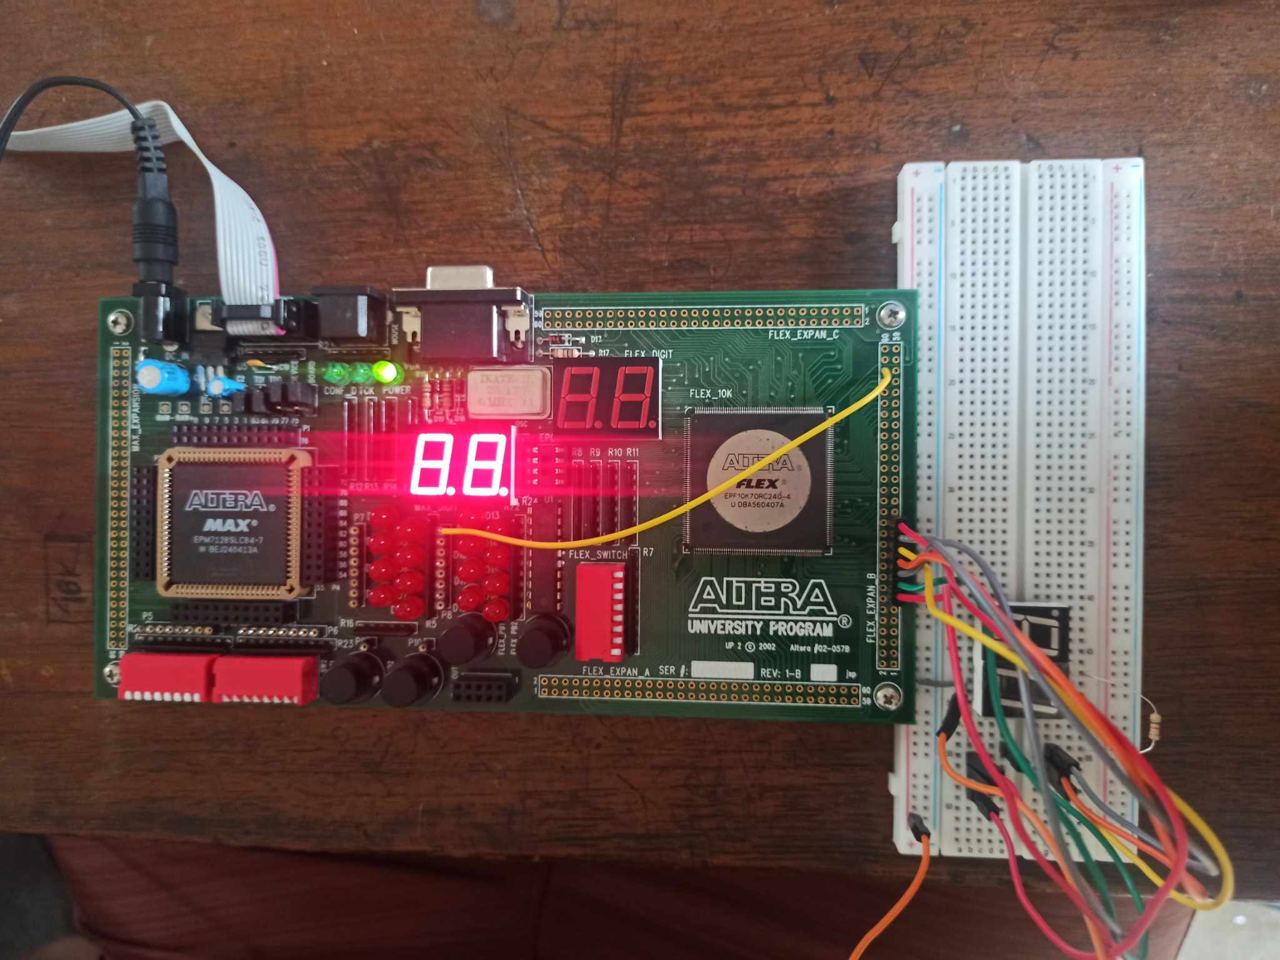
3.2 Design: Circuit Diagram
Presented by: 1706XXX

Slide 30
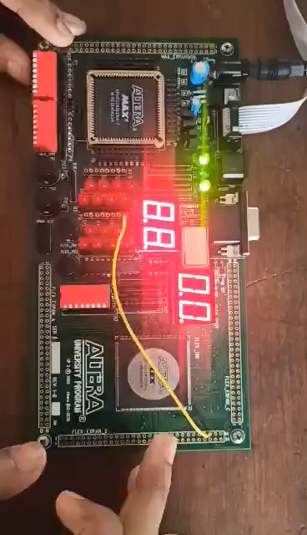
4 Implementation: Demonstration
Presented by: 1706XXX

Slide 31
4.1 Implementation: Photo Gallary
Presented by: 1706XXX

Slide 32
5. Analysis and Evaluation
5.1 Project Management and Cost Analysis
5.2 Practical Considerations of the Design
5.3 Assessment of the Impact of the Project
5.4 Evaluation of the Sustainability
Presented by: 1706XXX

Slide 33
5.1 Project Management and Cost Analysis
Bill of Materials
Component | Cost
Altera UP2 Development Kit | -
7 segment displays X 2 | 50
Resistors and Wires | 20
Presented by: 1706XXX

Slide 34
5.2 Practical Considerations of the Design
Considerations to Public Health and Safety:
Safe operation:
This Vending machine control circuit does not contain any hazardous power source or any component that has to be disposed carefully. Also the circuit operates on low voltage hence the whole design assures safety.
Presented by: 1706XXX

Slide 35
5.2 Practical Considerations of the Design
Considerations to environment:
Considerations to cultural and societal needs
Variety of Products:
Energy Efficient:
This vending machine circuit runs on any DC power source. This DC source can be replaced by any source of renewable enegry, hence can be environment friendly.
Varied selection of products are based on personal tastes and preferences of different age groups.
Presented by: 1706XXX

Slide 36
5.4 Assessment of the Impact of the Project
5.4.1 Assessment of Societal Issues:
Social responsibility: demonstrating social responsibility by sourcing products from ethical suppliers, supporting fair labor practices.
5.4.2 Assessment of Health and Safety Issues:
Food Security: In regions with limited access to affordable, nutritious food, vending machines can serve as valuable resources.
5.4.3 Assessment of Legal Issues:
Consumer protection law & taxation: A vending machine can maintain all the consumer laws and tax payment as per the running acts.
5.4.4 Assessment of Cultural Issues :
Cultural Representation: Reflect cultural diversity in the brading and marketing of products.
Presented by: 1706XXX

Slide 37
5.5 Evaluation of the Sustainability
5.5.1 Evaluation of Sustainability:
All the materials of the vending machine controller as well as overall vending machine are sustainable. As it uses the best parts and components from tech giants like INTEL.
5.5.2 Evaluation of Impact of Design in Societal Context:
As the vending machine is designed for all age group and people with special needs in the society.
5.5.3 Evaluation of Impact of Design in Environmental Context:
This vending machine is designed as environment friendly. It can draw power from rechargeable battery which is charged from any renewable sources.
Presented by: 1706XXX

Slide 38
6. Reflection on Individual and Team work
6.1 Individual Contribution of Each Member
6.2 Mode of TeamWork
6.3 Diversity Statement of Team
6.4 Log Book of Project Impelementation
Presented by: 1706XXX

Slide 39
6.1 Individual Contribution of Each Member
Student ID | Contribution
1906177 | Implementation of the code in FPGA
1906178 | Designing the Moore and Mealy FSM
1906191 | Designing State Table and Expressions using Kmap
1906195 | Implementing the code
Presented by: 1706XXX

Slide 40
6.2 Mode of TeamWork and Diversity
Our project team consists of four dedicated individuals who not only work diligently but also know how to create a vibrant and enjoyable work environment. Our working procedure is a harmonious blend of productivity and camaraderie.
We start our workdays with a brief team huddle, setting clear goals and priorities. As we dive into our tasks, we maintain open lines of communication, supporting each other's progress and sharing insights. Collaboration is at the core of our approach, and we often brainstorm ideas collectively, leveraging the diverse perspectives of our team members.
Presented by: 1706XXX

Slide 41
6.3 Logbook of Project
Date | Milestone Achieved | Individual Role | Team Role | Comment
July 7 | Implementation of Mealy Machine | 1906178- Design of FSM and Verilog 1906177 – Deriving Equations using Kmap 1906191- Calculation of No, of IC’c Needed
August 8 | Design of Moore Machine | 1906195 – Design of State Diagram and State Table
August 27 | Collecting FPGA | 1906177, 1906195 – Using the FPGA To upload a random code and checkin the i/o pins of the board
September 7 | Finalizing the project | Everyone
Presented by: 1706XXX

Slide 42
7. References
Presented by: 1706XXX

Slide 43
THANK YOU
Presented by: 1706XXX

